Slide 1
Convolutional layers optimization (Work in progress)
Jakob Kruse (IFAG DES SDF SCS SEM)
28.05.2020

Slide 2
Conv Layer

Slide 3
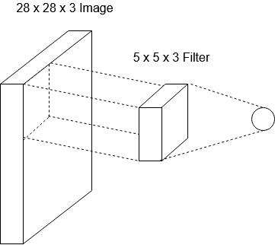
Convolutional layers
equal
Input_x
Input_y
Input_c
filter_x
Input_c
filter_y
One output neuron
Convolve the filter with the image using dot product

Slide 4
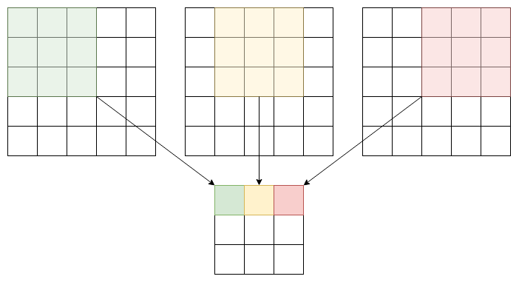
Convolutional layers
Input
Input_x * Input_y * Input_c
Output
Out_x * Out_y * 1
Out_x = (Input_x – Filter_x + 1) / stride
Out_y = (Input_y – Filter_y + 1) / stride

Slide 5
Convolutional layers
Input
Input_x * Input_y * Input_c
Output
Multiple Filters (n filters)
Out_x * Out_y * n
Out_x = (Input_x – Filter_x + 1) / stride
Out_y = (Input_y – Filter_y + 1) / stride
Batches not mentioned yet

Slide 6
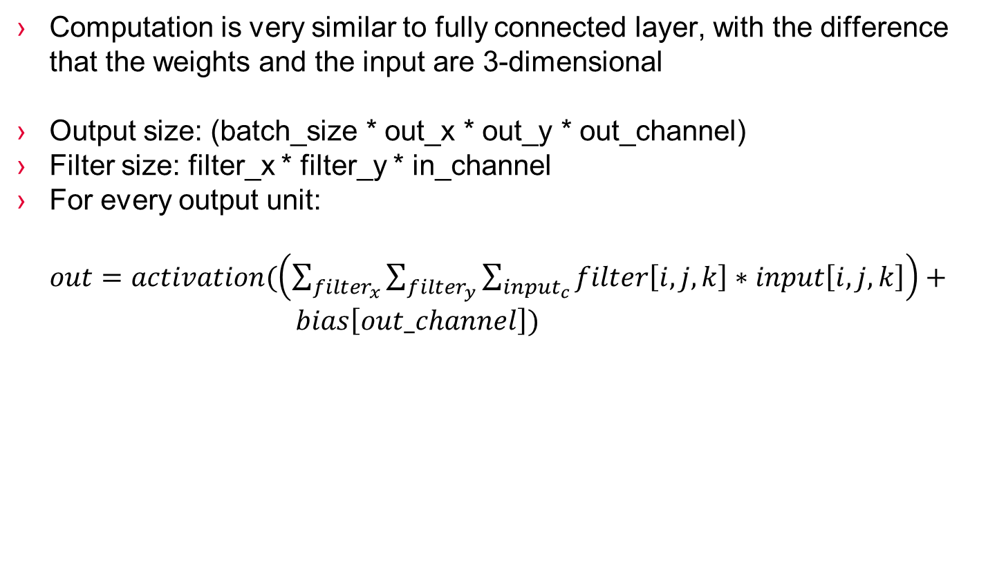
FLOAT Convolutional layer calculations
Computation is very similar to fully connected layer, with the difference that the weights and the input are 3-dimensional
Output size: (batch_size * out_x * out_y * out_channel)
Filter size: filter_x * filter_y * in_channel
For every output unit:
$out=activation(\left(\sum_{filter_{x}}{\sum_{filter_{y}}{\sum_{input_{c}}{filter\left[i,j,k\right]∗input\left[i,j,k\right]}}}\right)+ bias\left[out_channel\right])$

Slide 7
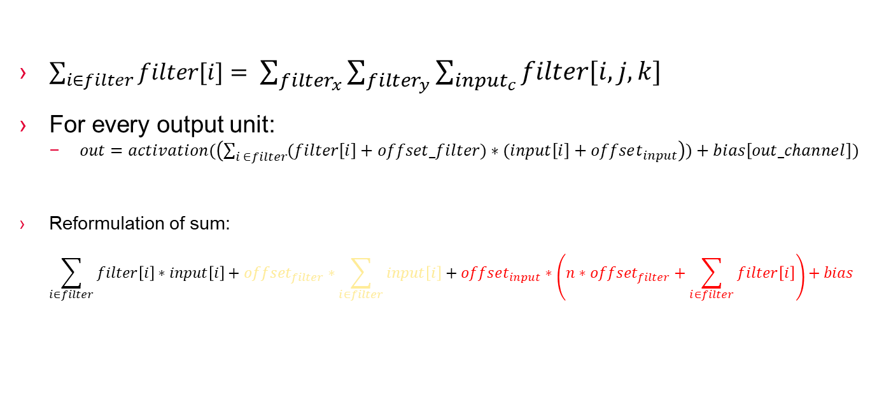
UINT8 Convolutional layer calculations
$\sum_{i∈filter}{filter[i]}= \sum_{filter_{x}}{\sum_{filter_{y}}{\sum_{input_{c}}{filter\left[i,j,k\right]}}}$
For every output unit:
$out=activation(\left(\sum_{i ∈filter}{(filter\left[i\right]+offset_filter)∗(input\left[i\right]+offset_{input}}\right))+bias\left[out_channel\right])$
Reformulation of sum:
$$\sum_{i∈filter}{filter\left[i\right]∗input\left[i\right]+offset_{filter}∗\sum_{i∈filter}{input\left[i\right]}+offset_{input}∗\left(n∗offset_{filter}+\sum_{i∈filter}{filter\left[i\right]}\right)+bias}$$
New-input-factor
Must be calculated every time
Sum-of-input-factor
Used multiple times (n=out_channel)
Should only be computed once
Not worth optimizing
Sum-of-filter-factor (with bias)
Always the same (can be precomputed)
Memory requirement: out_channel * int32
Finally, apply ouput shift, multiplier and offset and store value

Slide 8
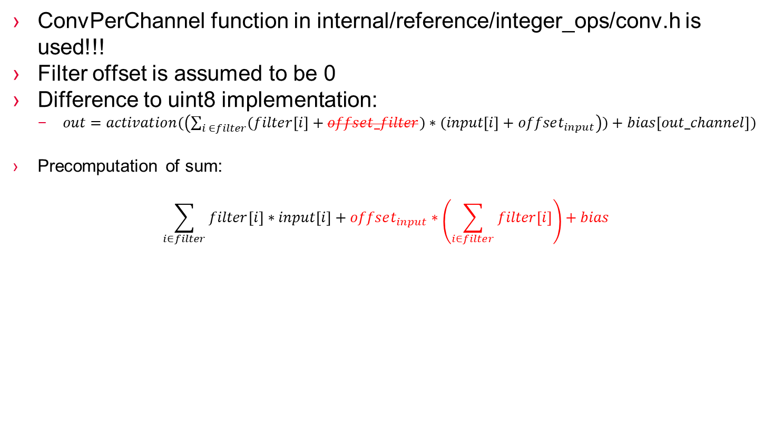
INT8 Convolutional layer calculations
ConvPerChannel function in internal/reference/integer_ops/conv.h is used!!!
Filter offset is assumed to be 0
Difference to uint8 implementation:
$out=activation(\left(\sum_{i ∈filter}{(filter\left[i\right]+offset_filter)∗(input\left[i\right]+offset_{input}}\right))+bias\left[out_channel\right])$
Precomputation of sum:
$$\sum_{i∈filter}{filter\left[i\right]∗input\left[i\right]+offset_{input}∗\left(\sum_{i∈filter}{filter\left[i\right]}\right)+bias}$$
New-input-factor
Must be calculated every time
Sum-of-filter-factor (with bias)
Always the same (can be precomputed)
Memory requirement: out_channel * int32

Slide 9
All optimizations I made
Dynamic memory allocation of OpData members
Moved CalculateOpData function call to Prepare phase
Precomputation of Sum-of-filters Factor
Precomputation of Sum-of-inputs Factor (not worth)
Loop variable optimization
Using filter consecutivity
Removing conditional statements
Causes problems if dilation factor is not 1
→ If dilation factor is not one, reference implementation is used

Slide 10
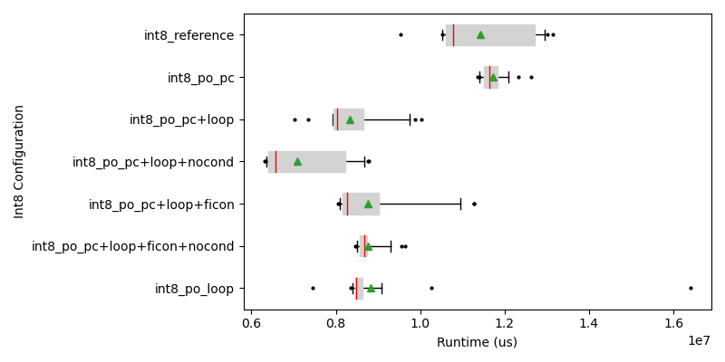
Benchmarks Int8
On host computer
PO: Portable optimized
Optimizations:
Precomputations(PC)
Loop Variables(Loop)
Filter consecutivity(Ficon)
Remove Conditionals (nocond)

Slide 11
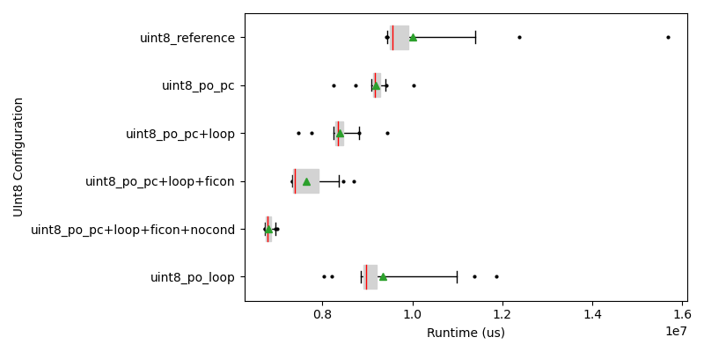
Benchmarks UInt8
On host computer
PO: Portable optimized
Optimizations:
Precomputations(PC)
Loop Variables(Loop)
Filter consecutivity(Ficon)
Remove Conditionals (nocond)

Slide 12
Benchmarks RISC V
UInt8 | Reference | Port. Optimized
Avg Time | 7360 | 1187
Int8 | Reference | Port. Optimized
Avg Time | 7053 | 1306

Slide 13
Depthwise Conv Layer (WIP)

